Slide 1
Poli’s Gogu
Laborant vocal
Proiect MPS

Slide 2
ECHIPA
Cutcunel Dragoș-Ioan
Damșa Elena-Veronica
Ene Andrei
Gheorghe Adrian-Valentin
Neamțu George
Popescu Ioana
341 C5

Slide 3
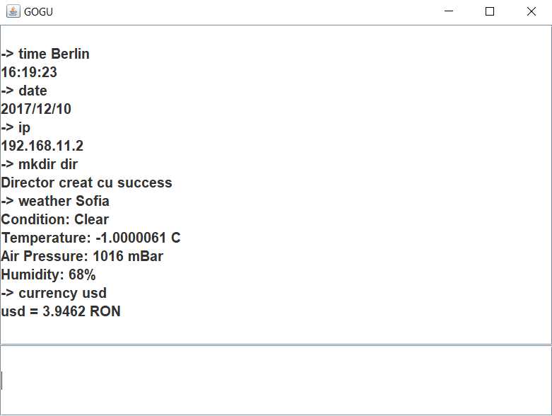
Who is Poli’s Gogu?

Slide 4




Tehnologii folosite

Slide 5
Comenzi de sistem
time [attr] -> 16:33:47 4. del [fileName]
date -> 2017/12/10 5. mkdir [directoryName] ->
Director creat cu succes
3. ip -> 192.168.11.2 6. shutdown

Slide 6
Comenzi pentru programe si aplicatii
notepad -> Notepad
cmd -> Windows Terminal
player -> Windows Media Player
calculator -> Calculator
paint -> Paint

Slide 7
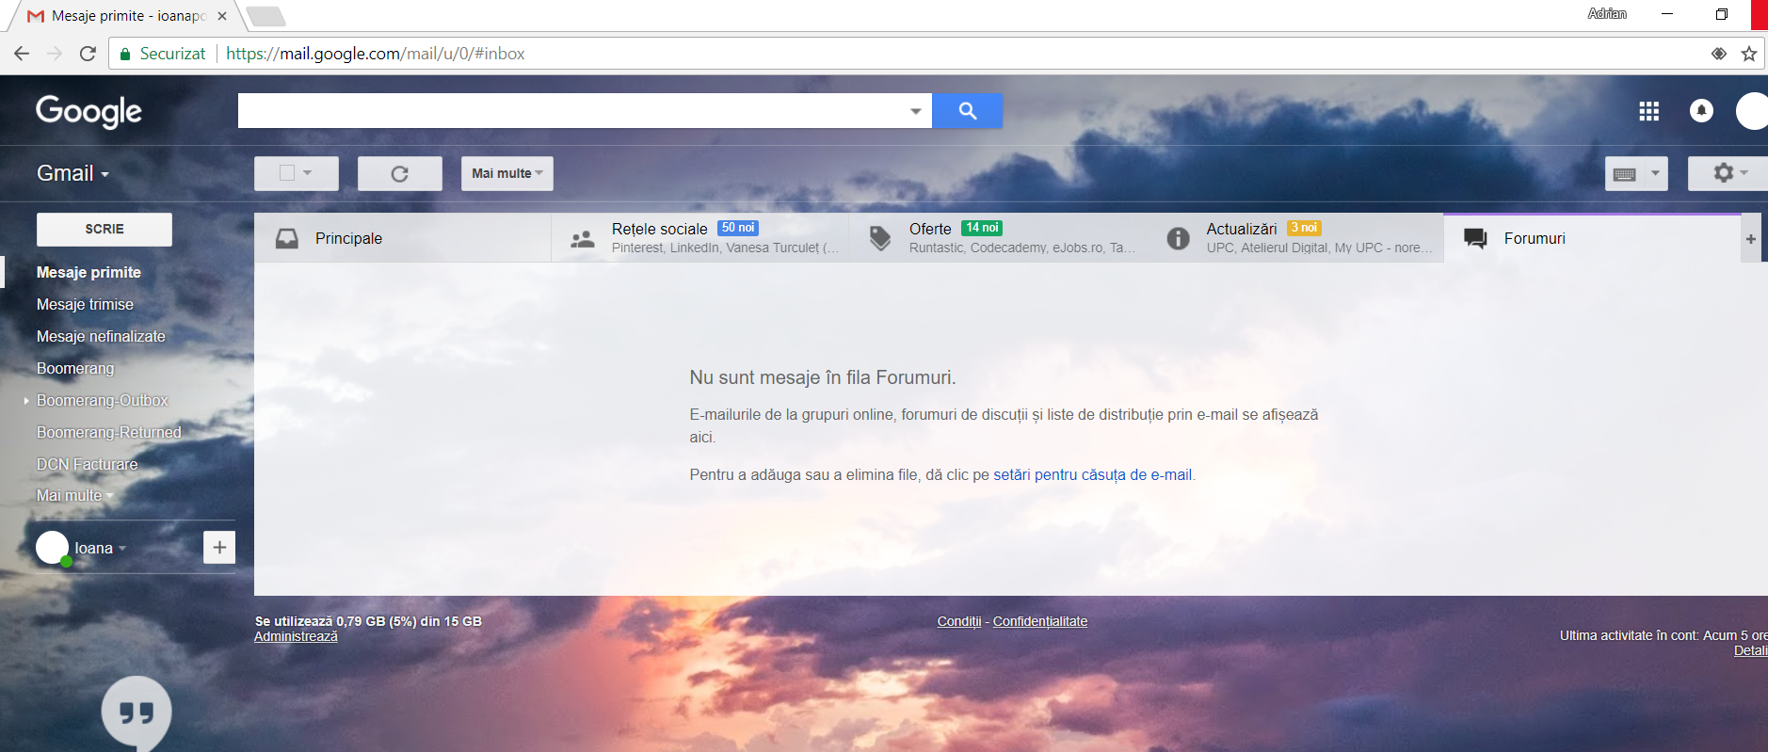
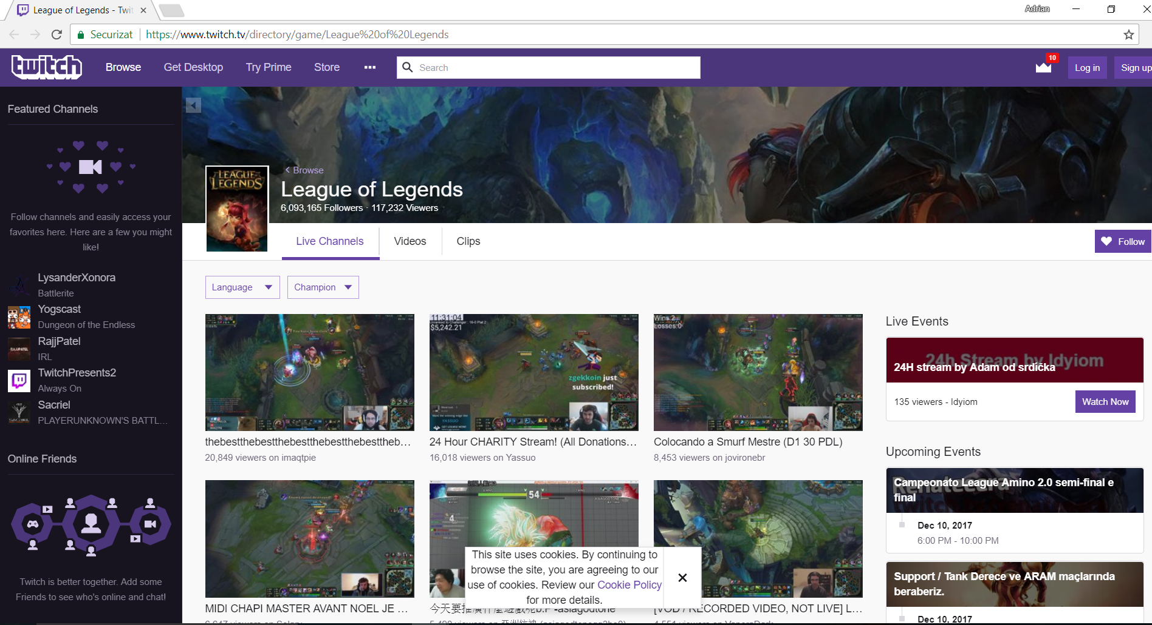
Functii care presupun utilizarea Internetului (1)
mail
2. twitch + [gameName]
(Ex: twitch League of Legends)

Slide 8
Functii care presupun utilizarea Internetului (2)
3. weather [attr] -> Ex: weather Bucharest Condition: Clear Temperature: 5.490016C Air Pressure: 1012 mBar Humidity: 60%
4. currency [attr] -> Ex: currency eur eur = 4.6336 RON
currency inr inr = 0.061228 RON

Slide 9
Documentatie
Documentul de specificatie a cerintelor
Documentul de organizare a proiectului
Documente de raportare saptamanala
2-minutes Meetings
Team Evaluation Form

Slide 10
Intrebari?

